Slide 1
Friday, January 13, 2017
Write In Your Agenda:
Write In Your Monitoring Log:
CW:
Qualitative vs. Quantitative Observation Sheet.
Scientific Method Review Squares.
HW:
Have Monitoring Log completed and signed.
Response to Warm-Up:
What are steps 5 & 6 of the Scientific Method?
You will need:
Pencil
Monitoring Log
Scientific Method Flipbook and/or notes.

Slide 2
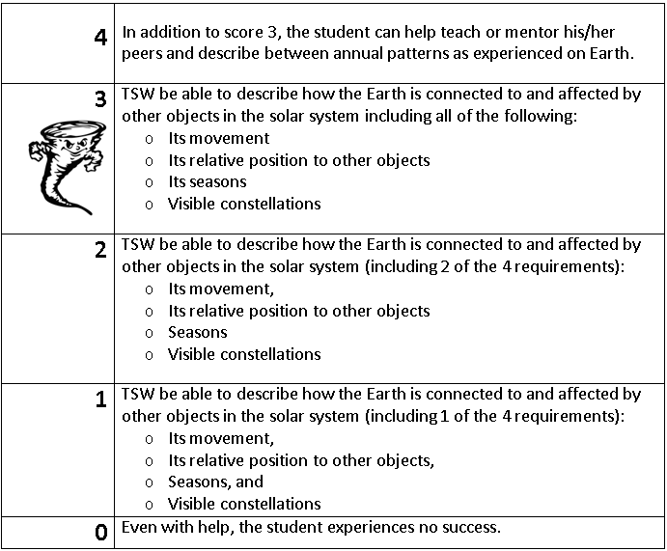
Learning Goal and Scale
TSW be able to describe how the Earth is connected to and affected by other objects in the solar system (including its movement, its relative position to other objects, its seasons, and visible constellations).

